Slide 1
Highlights in Diabetes Care
Dr E C UCHEGBU
CONSULTANT ENDOCRINOLOGIST
CLINICAL LEAD
BARNSLEY INTEGRATED SERVICE

Slide 2
DIABETES STATISTICS – BARNSLEY
Non-Diabetic Hyperglycaemia* 3245
Non-Diabetic Hyperglycaemia < 40 years* 435
Type 2 Diabetes Mellitus¹ 16,555
Type 2 Diabetes Mellitus <40 years¹ 702
Type 1 Diabetes Mellitus¹ 1,230
*2022-2023 NDA – NHS DPP Dashboard
¹ NDA Core Quarterly Dashboard 01/01/2023 to 31/12/2023
Notes:
NHS DPP data collection started in 2017,most recent data covers 2022-23.

Slide 3
Diabetes Update
Prevention
Remission
Treatment
Notes:
Diabetes prevention is important because it has become one of the largest public health problem to date as a result is is very logical that efforts is made to prevent it in the first place. Furthermore , it has been recognised that decreased physical activity, overnutrition caused by changes in life style contribute to its rising incidence as well as death related to it. Several studies have proven that lifestyle interventions can effectively deter the progression of diabetes in individuals with impaired glucose tolerance. If the window of prevention is shifted earlier, diabetes may become a fortuitous event.
Can diabetes be prevented? In fact, the conclusion is very clear. In 1986, the first study in China investigating diabetes prevention was conducted in Daqing, where patients with impaired glucose tolerance (IGT) received lifestyle intervention, including diet control and exercise.16 The study was followed by the Diabetes Prevention Study (DPS) in Finland and the American Diabetes Prevention Program (DPP).17, 18 These studies have proved that lifestyle intervention can effectively deter the progression of diabetes for patients with IGT.
Ref:Pan X.R., Li G.W., Hu Y.H. Effects of diet and exercise in preventing NIDDM in people with impaired glucose tolerance. The Da Qing IGT and Diabetes Study. Diabetes Care. 1997;20:537–544.
Lindström J., Louheranta A., Mannelin M. The Finnish Diabetes Prevention Study (DPS): lifestyle intervention and 3-year results on diet and physical activity. Diabetes Care. 2003;26:3230–3236.
Knowler W.C., Barrett-Connor E., Fowler S.E. Reduction in the incidence of type 2 diabetes with lifestyle intervention or metformin. N Engl J Med. 2002;346:393–403

Slide 4
Diabetes Prevention
T2DM is preventable /onset can be delayed
NDPP - The NHS Diabetes Prevention Programme (NHS DPP) - evidence based behavioural interventions for individuals identified as being at high risk of developing Type 2 diabetes.
The long-term aims of the NHS DPP are:
• To reduce the incidence of Type 2 diabetes;
• To reduce the incidence of complications associated with diabetes
• Over the longer term, to reduce health inequalities associated with incidence of diabetes.
The NDPP is associated with reduced conversion rates from NDH to T2DM
Notes:
The NHS Diabetes Prevention Programme (NHS DPP) is a joint commitment from NHS England, Public Health England and Diabetes UK, to deliver at scale, evidence based behavioural interventions for individuals identified as being at high risk of developing Type 2 diabetes.
The long-term aims of the NHS DPP are: • To reduce the incidence of Type 2 diabetes; • To reduce the incidence of complications associated with diabetes - heart, stroke, kidney, eye and foot problems related to diabetes; and • Over the longer term, to reduce health inequalities associated with incidence of diabetes.
“20-year follow-up study of China Daqing Diabetes Prevention”, which reported that 92% of the population with high diabetes risk were diagnosed with diabetes in the absence of intervention in 20 years; however, the figure was reduced by 43% after 20 years with only a six-year-long lifestyle intervention.19 These results illustrated that lifestyle intervention for diabetes prevention is definite and long-lasting
Li G., Zhang P., Wang J. The long-term effect of lifestyle interventions to prevent diabetes in the China Da Qing Diabetes Prevention Study: a 20-year follow-up study. Lancet. 2008;371:1783–1789.

Slide 5

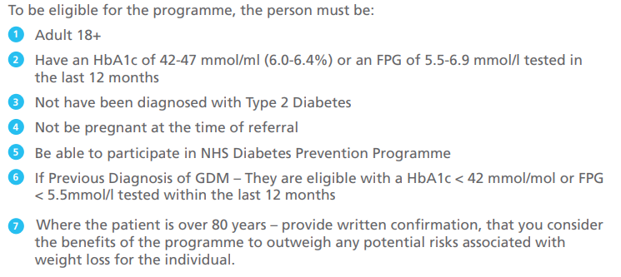
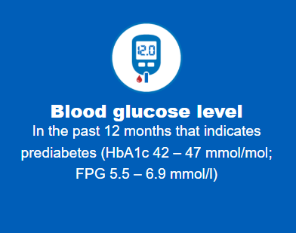
ELIGIBILITY
Notes:
The model has enabled us to estimate how different health policies can reduce the costs of diabetes and improve health for patients. We find that screening for type-2 diabetes followed by lifestyle education for high risk individuals is particularly cost saving and gives the largest health gains. Sugary drink taxation or community interventions to promote healthy diets lead to smaller improvements in health and smaller cost savings.

Slide 6
Referral Process: How to refer
Refer securely by:
Completing our electronic referral form through the Primary Care System.
Completing referral form and returning to healthieryou.syandb@nhs.net
Delivery Options
Face to face
Digital
Notes:
The Healthier You: NHS Diabetes Prevention Programme (NHS DPP) was officially launched in 2016 to support people who are at high risk of developing Type 2 diabetes. It is delivered by 4 main providers :-
• Pulse Healthcare Limited trading as ICS Health
• Ingeus UK
• Living Well Taking Control
• Reed Momenta

Slide 7
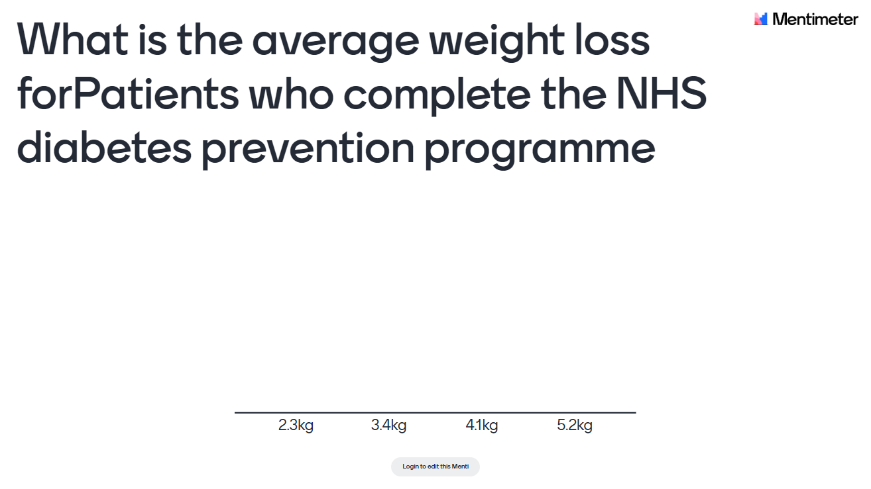

Slide 8
Cost Effectiveness of NDPP
Using a modelling tool developed by ScHARR, University of Sheffield
– Intervention cost £270 per patient and 5 years time to return to baseline after
intervention effect
- 1500 Offered NDPP Vs. 1500 Offered NDPP
- 30% Uptake = 450 50% Uptake = 750
- 18.7 less T2DM in 5 years 31 less T2DM in 5 years
- £58,268 cost saving in 5years £95,437 cost saving in 5 years

Slide 9



Message 1
Diabetes Prevention saves costs for the healthcare system
Consider interventions to increase referral and uptake rate

Slide 10
TYPE 2 DIABETES

Slide 11
Natural History of Type 2 Diabetes
Years from
diagnosis
–10
–5
0
5
10
15
Onset
Diagnosis
β-Cell function
Insulin resistance
Insulin secretion
Postprandial glucose
Fasting glucose
Microvascular complications
Macrovascular complications
Prediabetes
Type 2 diabetes
Figure courtesy of CADRE.
Adapted from Holman RR. Diabetes Res Clin Pract. 1998;40(suppl):S21-S25;
Ramlo-Halsted BA, Edelman SV. Prim Care. 1999;26:771-789; Nathan DM. N Engl J Med. 2002;347:1342-1349; UKPDS Group. Diabetes. 1995;44:1249-1258

Slide 12
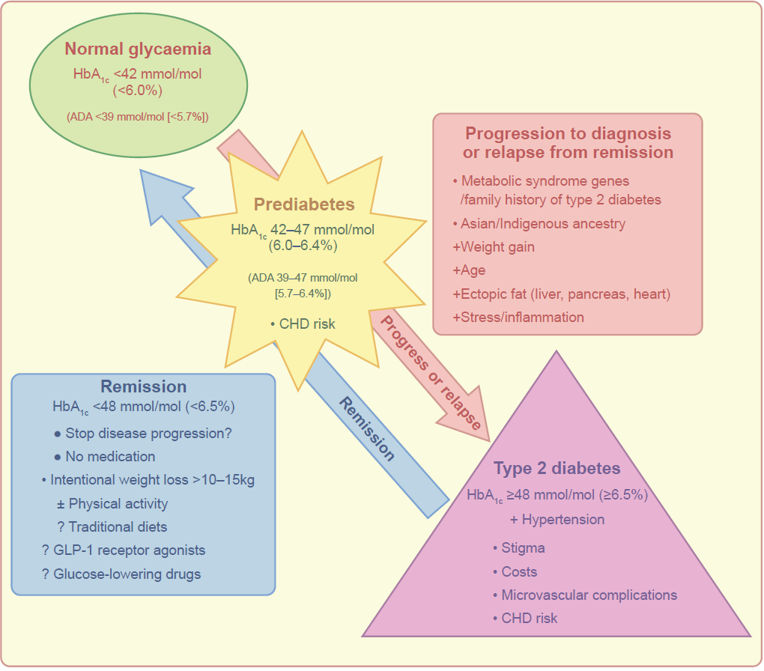
A schematic view of the progression of prediabetes to type 2 diabetes
Rothberg et al (2023) Diabetologia DOI 10.1007/s00125-023-06069-1
©The Authors 2023. Distributed under the terms of the CC BY 4.0 Attribution License (http://creativecommons.org/licenses/by/4.0/)

Slide 13
CAN YOU REVERSE T2DM ?

Slide 14
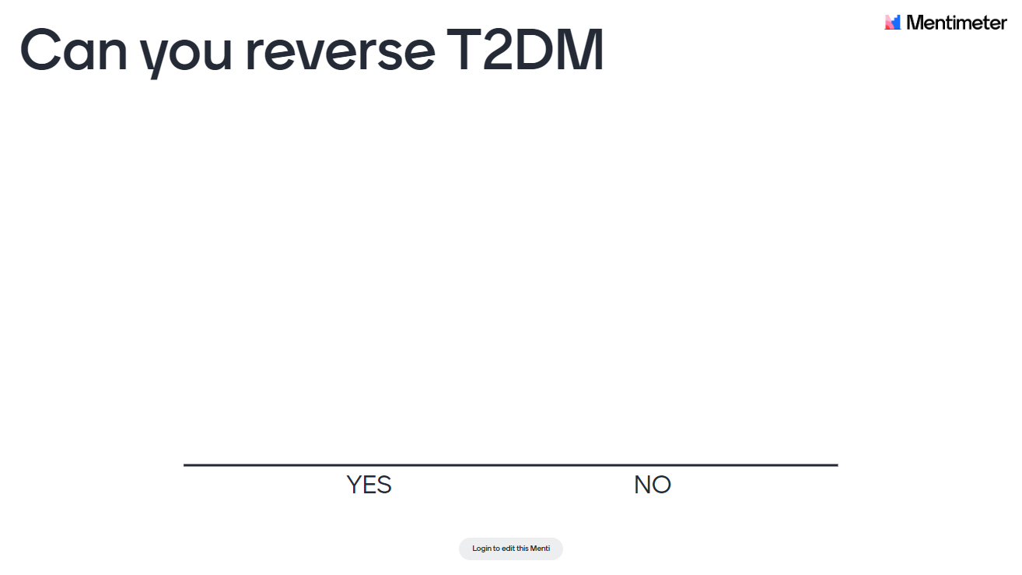

Slide 15
T2DM REMISSION
Non detection of the original disease – in this case T2DM
Not cure, reversal or regression
Risks of recurrence remains
Most likely for people diagnosed with T2DM for a short time(6 years or less)
Overweight/Obese motivated to lose weight
With modest elevation of blood glucose
Who do not require to take Insulin to control glucose levels

Slide 16
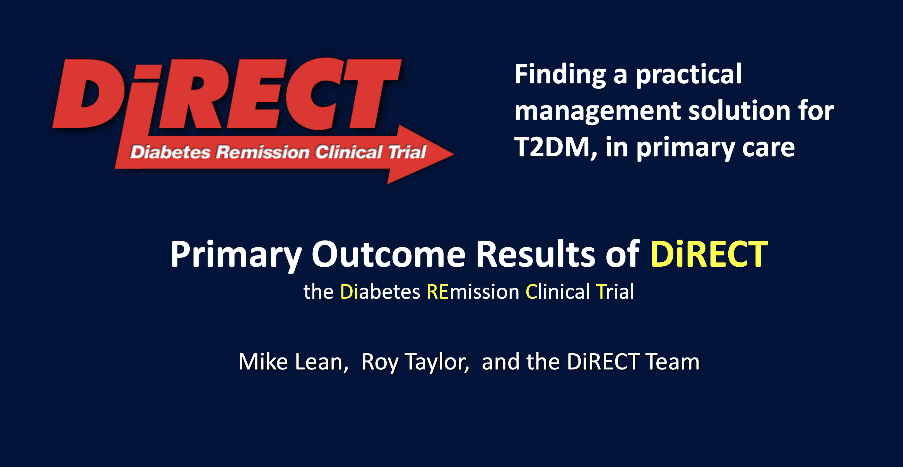

Slide 17
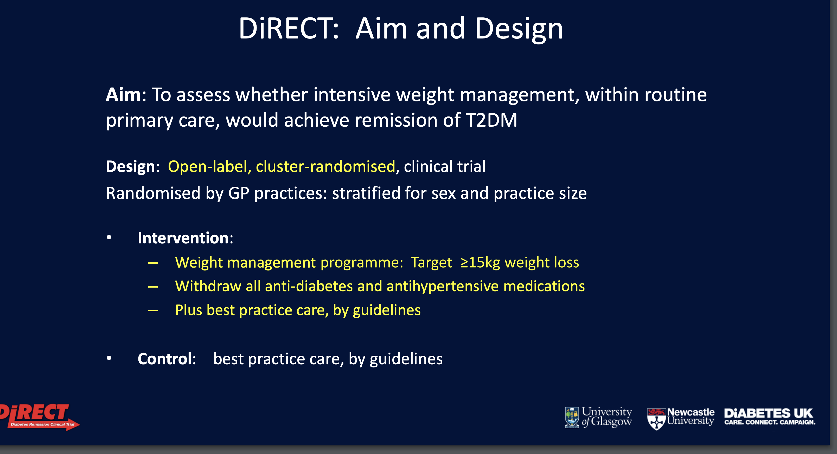

Slide 18
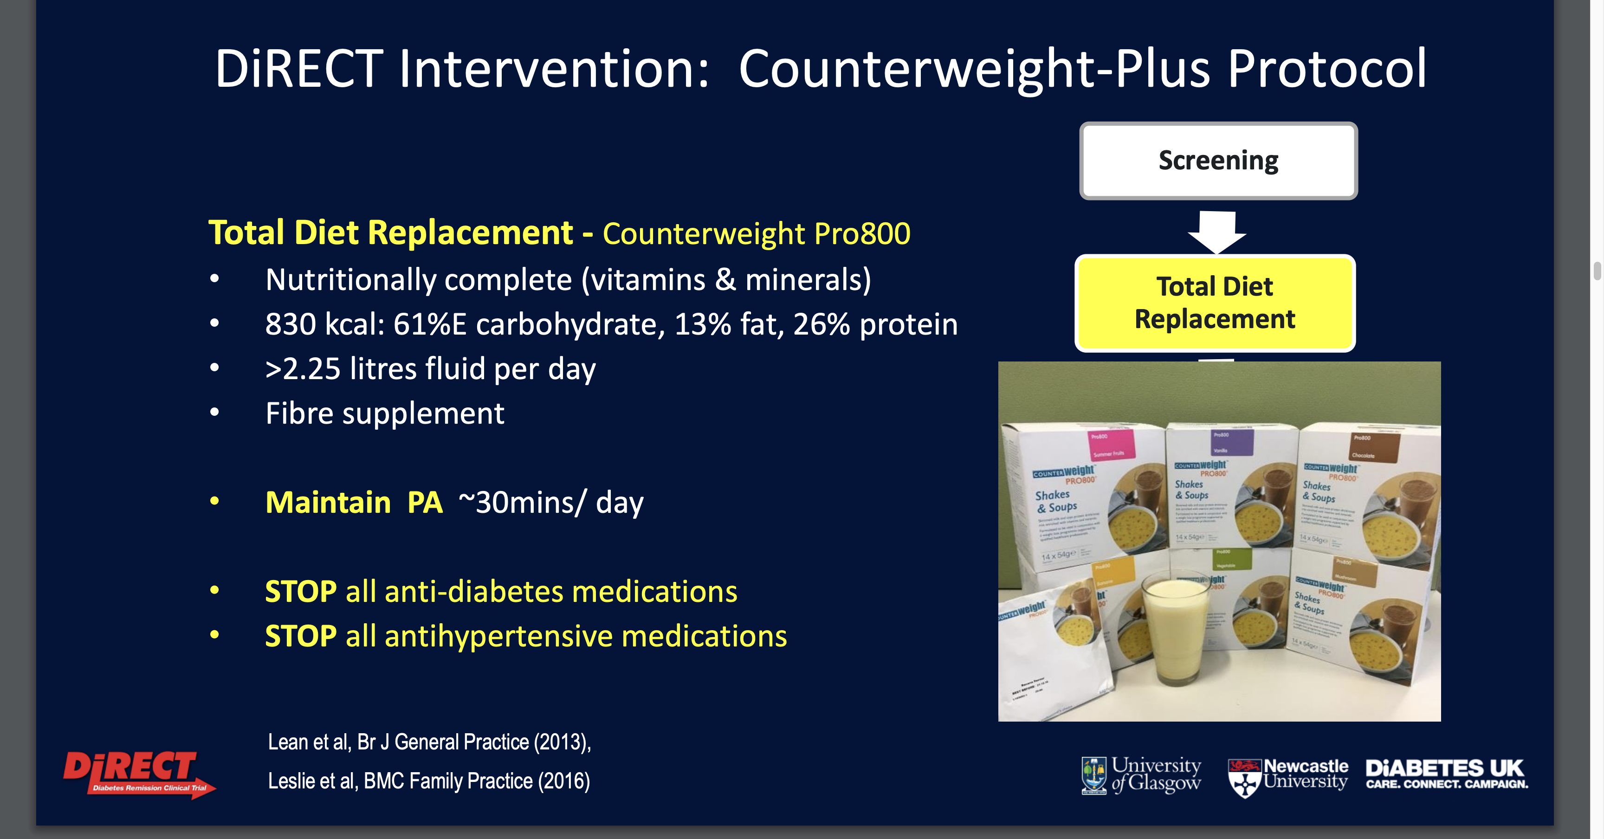

Slide 19
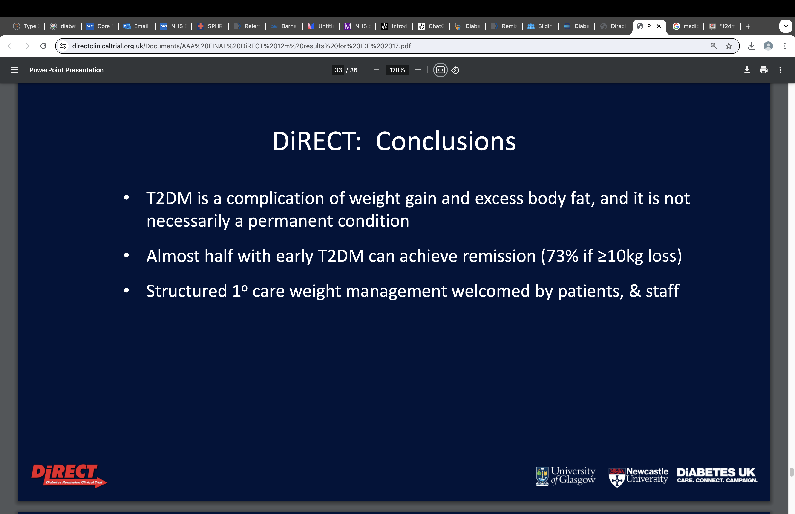

Slide 20
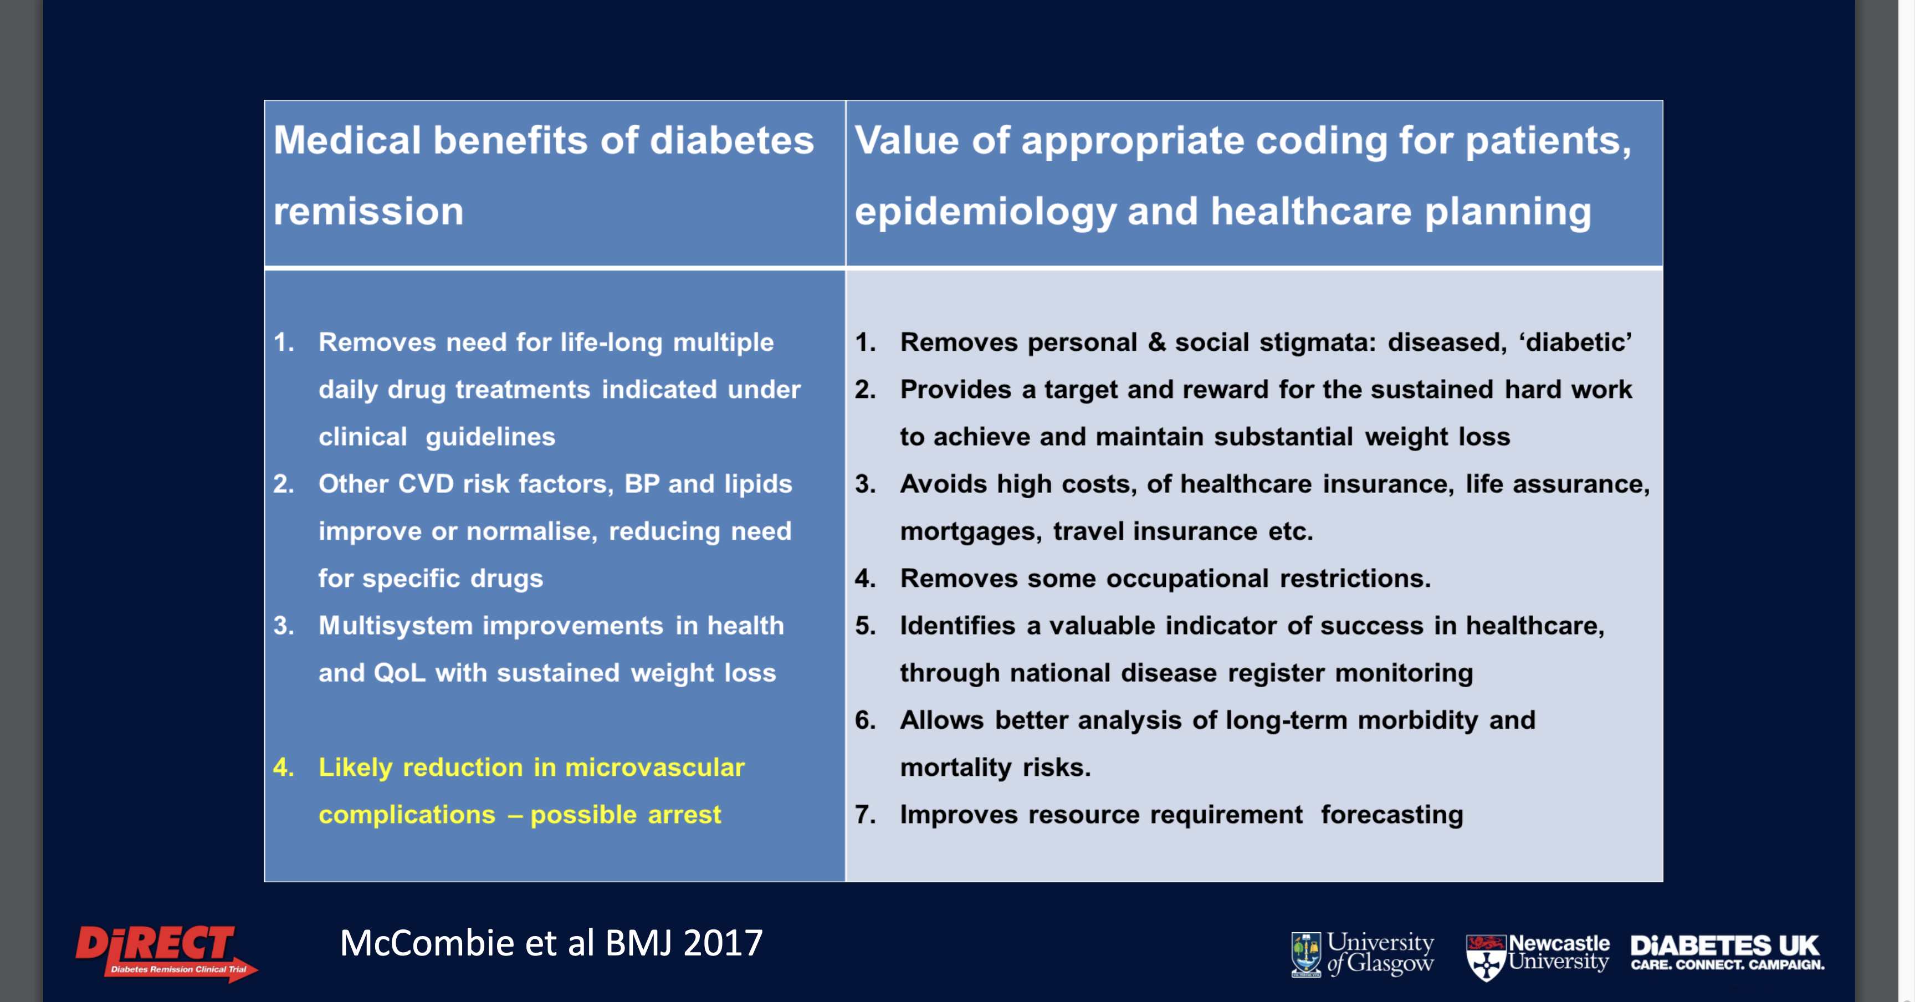

Slide 21
Type 2 Diabetes Mellitus Remission
T2DM Remission defined as as an HbA_{1c} below the diagnostic threshold of 48 mmol/mol [6.5%] without taking glucose-lowering medication maintained for a minimum of 6months.
Check HbA1c and Renal Function annually
Continue Retina Screening and Foot Screening
Continue to monitor and manage CVD risk factors
Code as 'diabetes in remission ' C10p and not Diabetes Resolved

Slide 22

NHS Type 2 Diabetes Path to Remission Programme
Previously known as ‘NHS Low Calorie Diet’
  Eligibility, content, Coach support for 12-months
For patients diagnosed with Type 2 diabetes in last 6 years
  Based on DiRECT and DROPLET studies
Three phases (not just ‘soups and shakes’):
  Total Diet Replacement (12 weeks)
  Food Reintroduction (6 weeks)
  Weight Maintenance (to 12 months, incl. Rescue packages)
NO COST to patients
Delivery format: participant choice of 1:1 in-person or digital

Slide 23
NHS Type 2 Diabetes Path to Remission Programme
In SY Delivered by Momenta Newcastle
As at 06/03/24 - 145 referred and 126 started

Slide 24
Eligibility criteria (summary)
Inclusion
Exclusion
Aged 18-65
T2D diagnosis within last 6 years
BMI >=27kg/m² (>=25kg/m² if BAME origin)
Attended monitoring and diabetes review in
last 12 months
HbA1c within 12 months:
  If on diabetes medication, HbA1c >=43 mmol/mol (6.1%)
  If not on diabetes medication, HbA1c >=48 mmol/mol (6.5%)
  In all cases, HbA1c must be <=87 mmol/mol (10.1%)
Current insulin user
Currently breastfeeding
Pregnant or planning pregnancy within 6 mths
Heart attack or stroke in last 6 months; severe heart failure (New York Heart Association grade 3 or 4); severe renal impairment (most recent eGFR <30mls/min/1.73m2); active liver disease (not including NAFLD); active substance use disorder; active eating disorder; porphyria; or known proliferative retinopathy that has not been treated
Had bariatric surgery
Health professional assessment; or for whom safe and robust medications adjustment is not practical in a primary care setting

Slide 25
Making a successful referral
Step 1: Identify & invite eligible patients
Search, screen and invite: searches, template SMS / letter, patient landing page
Opportunistically: Discuss at diagnosis, annual review, patient request
Bespoke: Patient event
Step 2: Referral appointment, including medications adjustments
Appointment (typically 15 mins): Explain programme and discuss medication changes
Make patient aware medication changes to start on day 1 of TDR
Provide patient with copy of MAF
Step 3: Send referral
Ensure all sections on referral form and MAF are fully completed and email to:
momenta.t2dr-syks@nhs.net

Slide 26
Mr KB
54 Years
Medically retired
Fracture of tibia and fibula 1989
OA Knees under Ortho
Hypertension 2013
T2DM diagnosed 2020
Weight 141.1kg, Height 177cm, BMI 45.2.
HbA1c 60
FH of T2DM – Brother
Medications
Mometasone 50mcgs/dose nasal spray
Pregabalin 150mgs bd
Amlodipine 10mgs od
Co-codamol 30/500 1-2 qds prn
Doxazosin 1mgs bd
Ibuprofen Gel PRN
Metformin 1grams bd
Sitagliptin 100mgs od

Slide 27
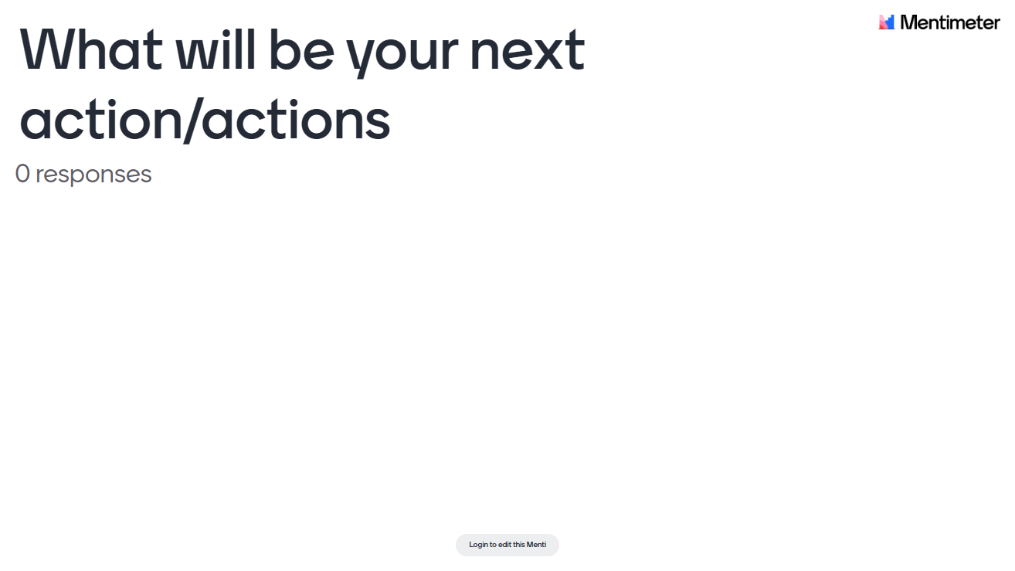

Slide 28
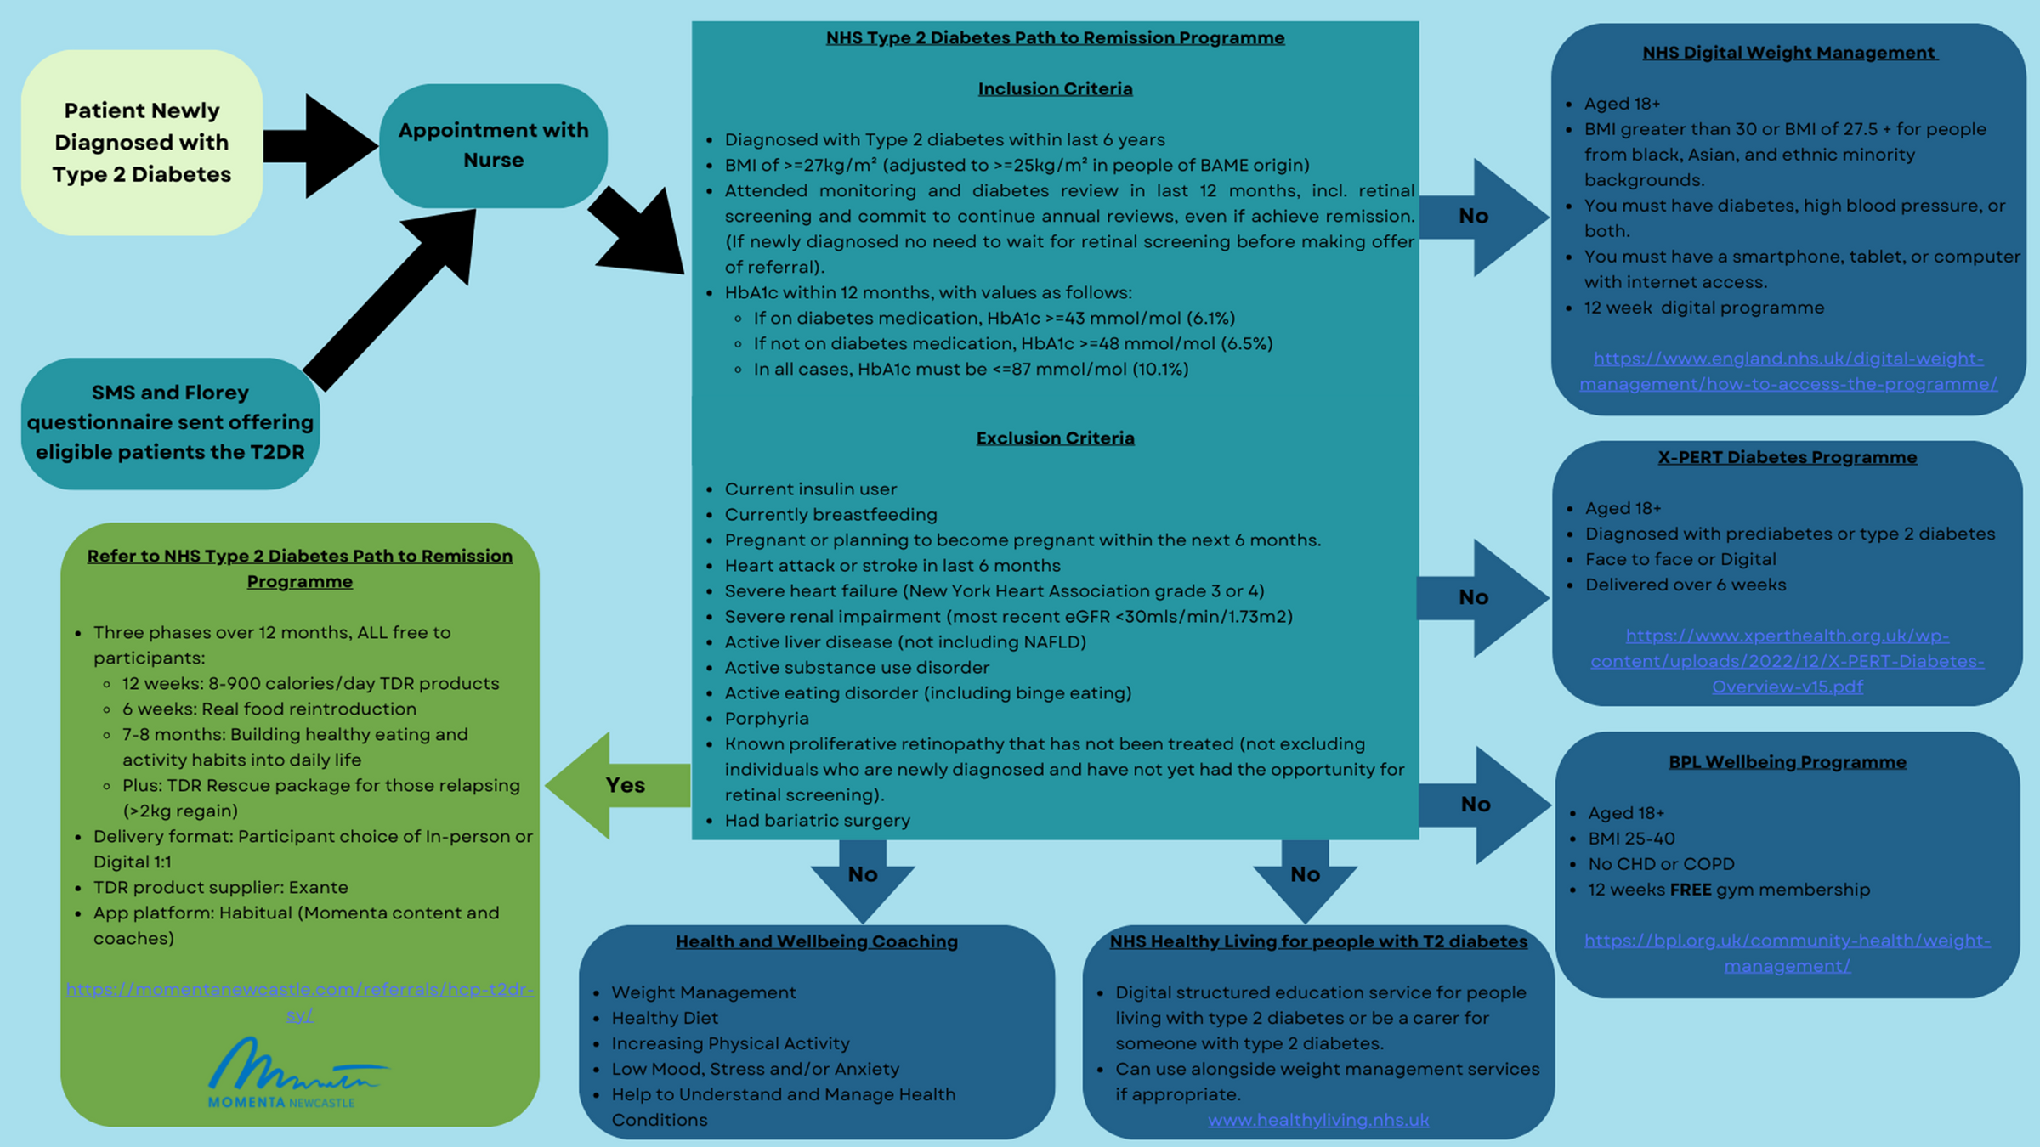

Slide 29


James Ball
Diabetes Health and Wellbeing Coach
james.ball12@nhs.net

Slide 30


Message 2:
T2DM Remission is possible for a good majority of patients who has had T2DM for 6 years or less

Slide 31
Type 2 Diabetes Treatment
HOW NICE ?

Slide 32
Choosing Treatment
Individualise – co-morbidities, contraindications, weight, polypharmacy, preference
Drug effectiveness
Safety and tolerability
Licensed indications
Cost
High risks of CVD - QRISK2 more than 10% in adults aged 40 and over or an elevated lifetime risk of cardiovascular disease (defined as the presence of 1 or more cardiovascular risk factors in someone under 40
Cardiovascular disease risk factors: hypertension, dyslipidaemia, smoking, obesity, and family history (in
a first-degree relative) of premature cardiovascular disease.

Slide 33
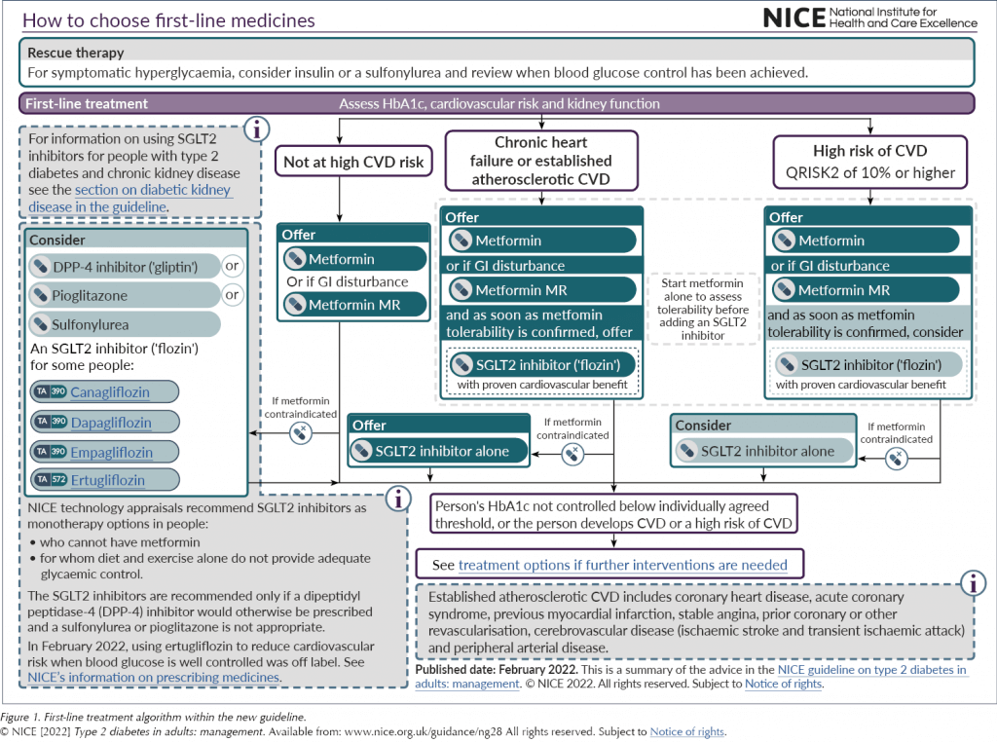

Slide 34
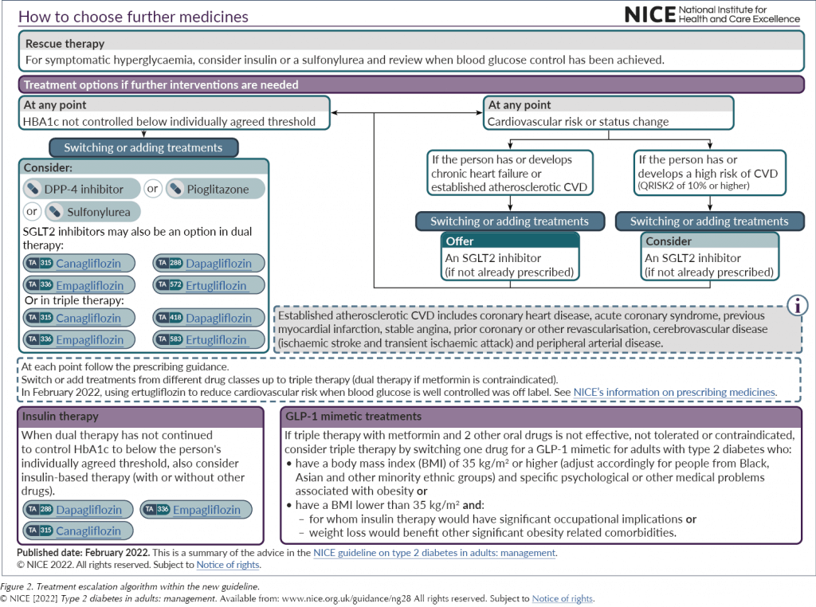

Slide 35
Miss CK
21years old
University Student
Presents with Thrush
Glycosuria ++
HbA1c 105mmol/mol
No recent weight loss, no polyuria, polydipsia
Weight 105kg, Ht 172 cm BMI 35.5
PMH – Nil significant
FSH – No FH of Diabetes Mellitus, diet somewhat extreme. 2 cans of Monster and 4 cans of coke daily.
What will you do next?

Slide 36
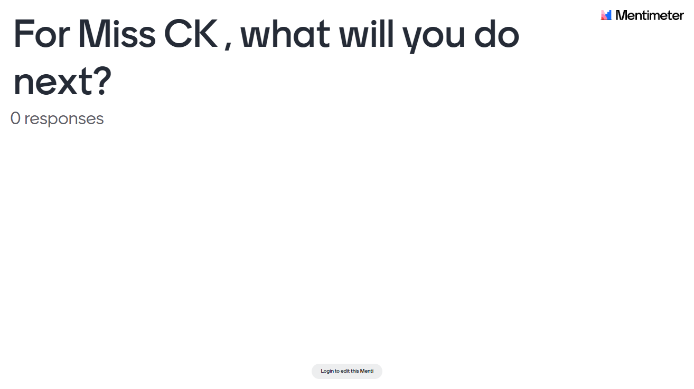

Slide 37
GLP 1 RAs

Slide 38
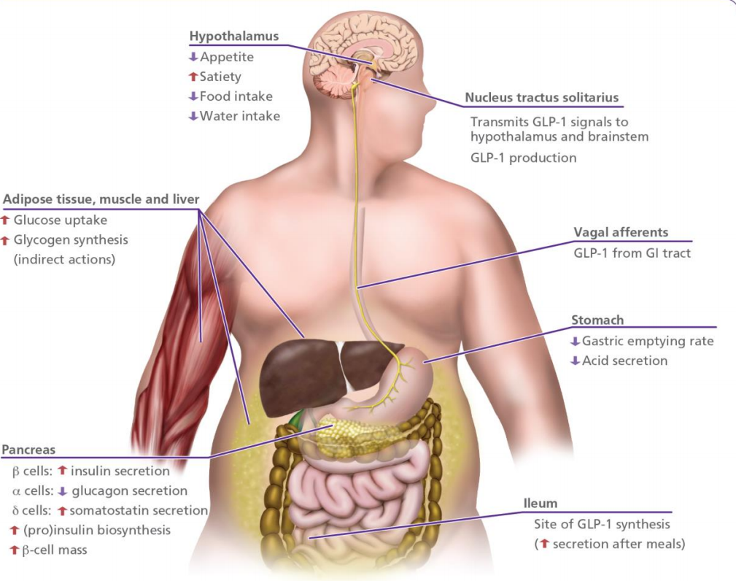
The metabolic effects of GLP-1

Slide 39
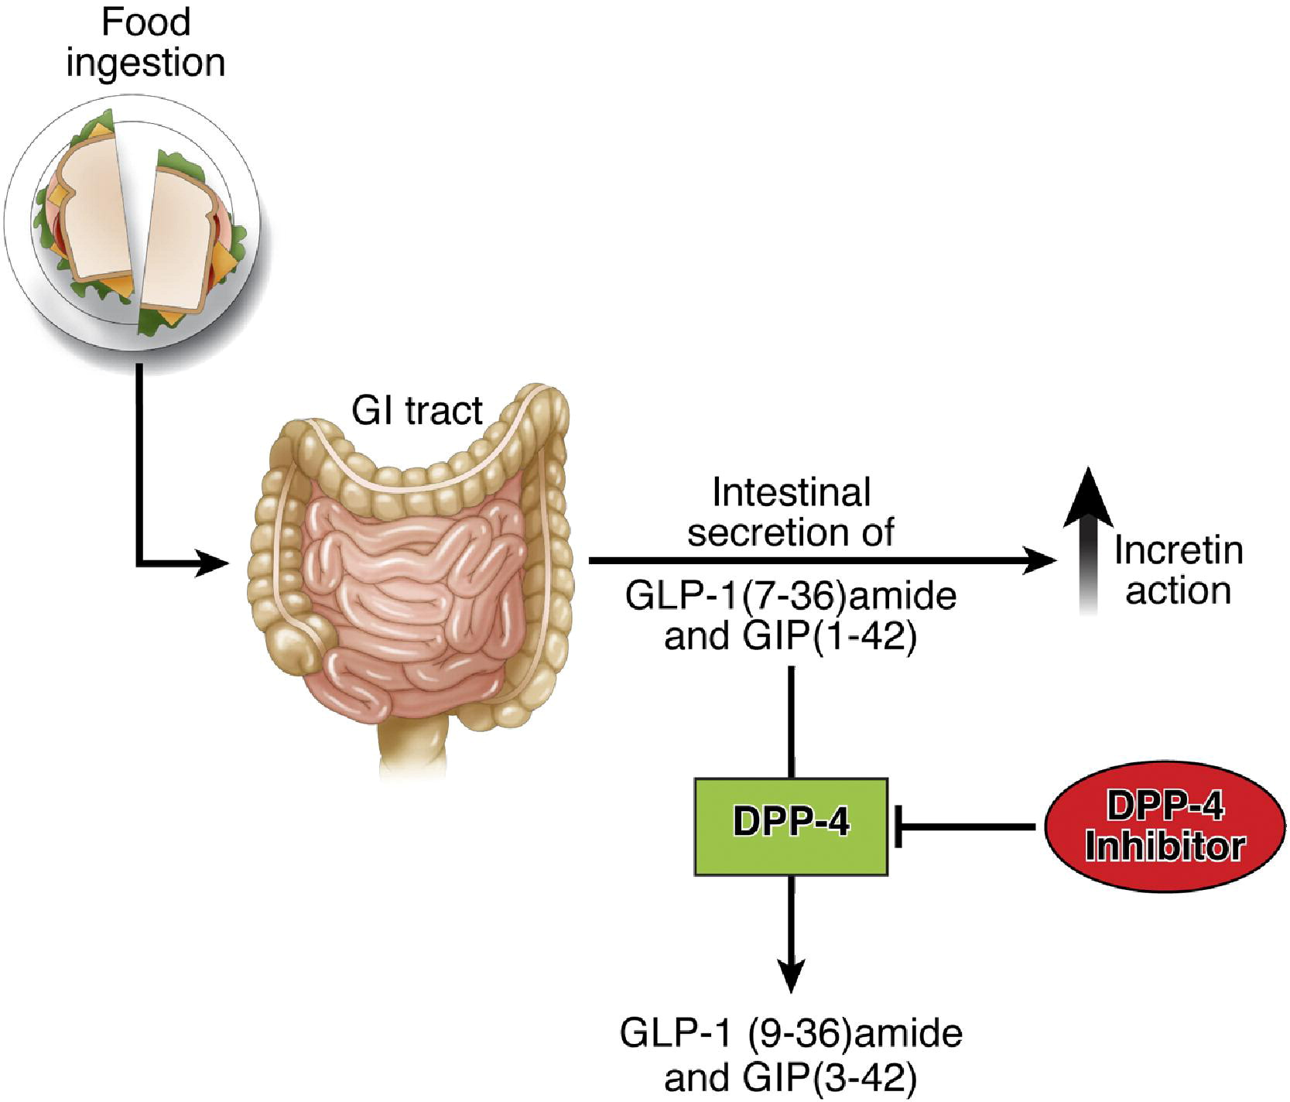
Gastroenterology 2007 1322131-2157DOI: (10.1053/j.gastro.2007.03.054)
Copyright © 2007 ACopyright © 2007 AGA Institute Terms and Conditions

Slide 40
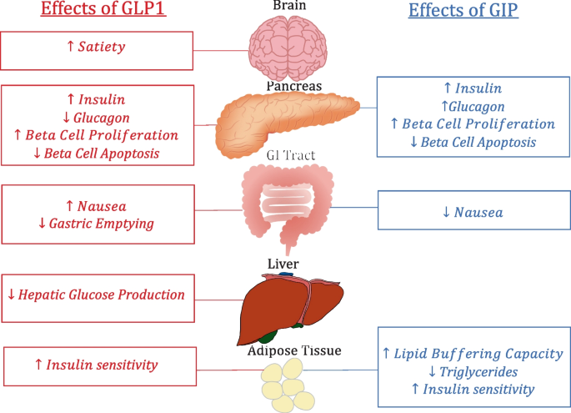

Slide 41
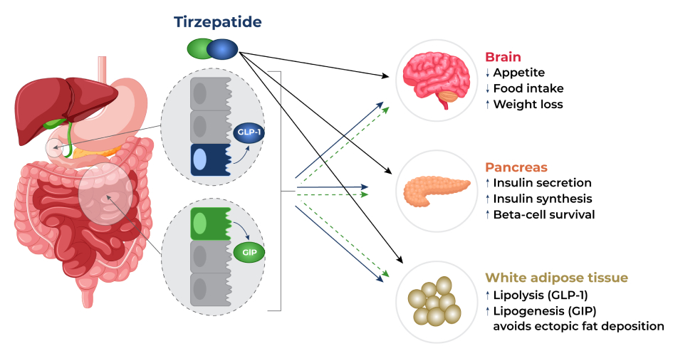

Slide 42
Currently Available GLP -1 RA
Dulaglutide - Trulicity – SC Once weekly
Exenatide – Bydureon – SC Once weekly – note Byetta discontinued from 03/2024
Liraglutide – Victosa – SC Daily, Note Saxenda for weight management
Lixisenatide – Lyxumia – SC Daily
Semaglutide – Ozempic SC once weekly , Rybelsus** – oral once daily , Wegovy once weekly for weight management
Dual GLP 1 and GIP RA
Tirzepatide – Mounjaro** SC once weekly
To date, only liraglutide, semaglutide, and dulaglutide have licensed indications for the prevention of cardiovascular disease.

Slide 43
Mr JK
56years
Plumber
T2DM 16years
Hypertension 16years
BMI 42
H/O ED
Depression
“ I am bad diabetic”
Stopped smoking , weight increased by 9kgs
Erectile problems
Binge drinking following recent divorce
Business going well

Slide 44
Mr JK –cont’d
Metformin 1gram bd
Gliclazide MR 60mgs od
Ramipril 10mg od
Atorvastin 20mgs nocte
Sildenafil 100mgs PRN
Sitagliptin 100mgs od
Atenolol 50mgs od
Sertraline 100mgs od
Omeprazole 20mgs od
Aspirin 75mgs od
BP 145/100mmHg
ACR 50mg/mmol
eGFR 60
HbA1c 70mmol/mol
Total Cholesterol 6.0mmol/mol
LFTs Normal
Testosterone level Normal

Slide 45
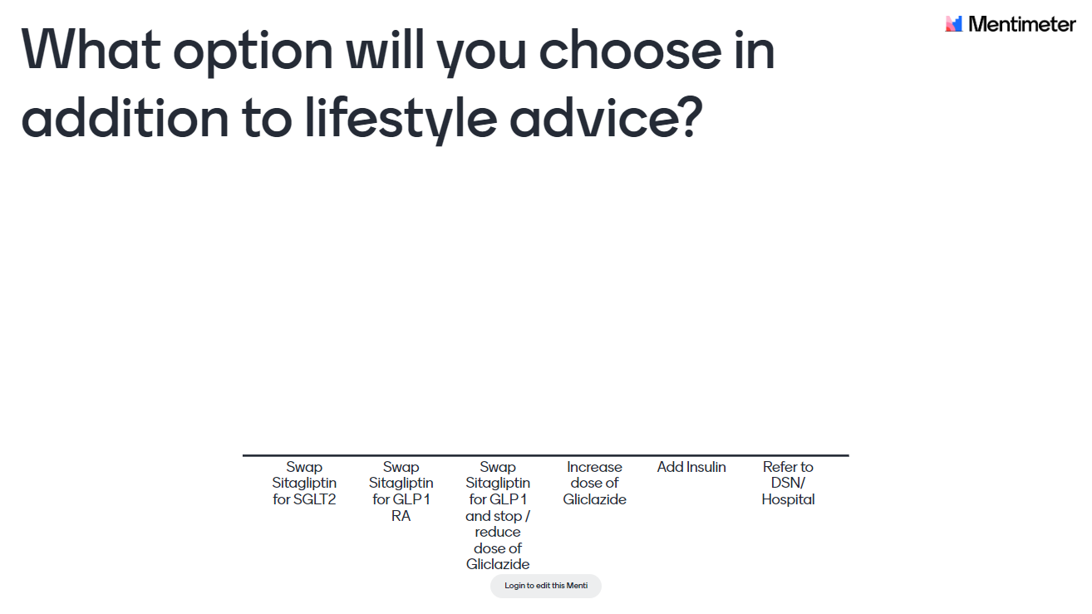

Slide 46
SGLT 2s
Given more prominence in the most recent NICE Guideline – NG28.
NG28 encourages the identification of those with either atherosclerotic cardiovascular disease (ASCVD), chronic heart failure or high risk of CVD
Any patient falling into these three categories above, whether initially or at a subsequent review, offer dual therapy with metformin and an SGLT2 inhibitor with proven cardiovascular benefit
SGLT2 inhibitors also also to be offered to all people with type 2 diabetes and chronic heart failure
Risks of DKA – avoid in patients with previous DKA and suspend during intercurrent illness.
NG203 recommends offering an SGLT2 inhibitor in addition to an ACEi/ARB in all those with an albumin:creatinine ratio (ACR) >30 mg/mmol.

Slide 47
Barnsley 2022 so far: 8 Care Processes & Treatment Targets

Slide 48
T2DM IN YOUNG ADULTS
Adult Onset Diabetes Vs Young Adult Diabetes
Both increasing in prevalence
Young Adult Diabetes = Adult Onset Diabetes X
Differences – life-style, lost years of healthy life, lost years of productivity
Under representation of individuals with early-onset adult type 2 diabetes in the prominent research trials that underpin type 2 diabetes management guidelines

Slide 49
What is the T2Day?
The T2Day is the Type 2 diabetes in the young programme - an NHSE 2-year initiative to improve care for people with Early Onset Type 2 Diabetes (EOT2D) affecting those aged between 18-39. A targeted improvement approach is proposed to improve outcomes for people with diabetes and reduce health inequalities, downstream activity, and healthcare costs.

Slide 50



The T2Day Approach in South Yorkshire.
Ani Kumar
SYICB Diabetes Programme Manager.
T2Day Programme Lead
DUK Clinical Champion

Slide 51




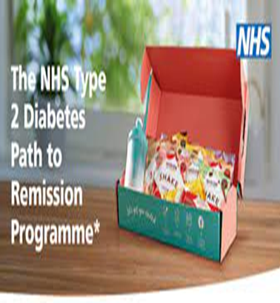
SY T2Day Model of care and our strategy
… What are we going to do and how ?
Remission
Prevention
Integration
Engagement
Education

Slide 52
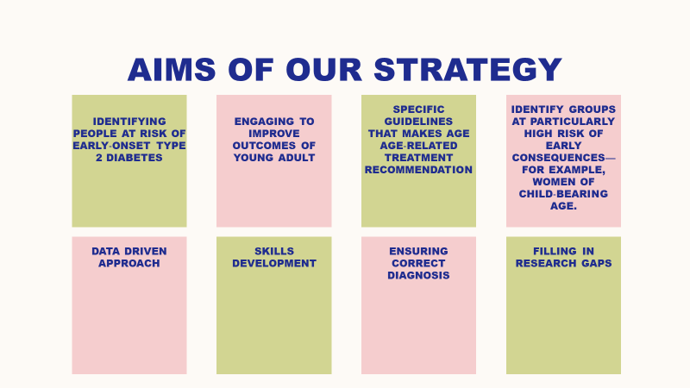
SY T2Day Model of care
… What are we going to do ?

Slide 53




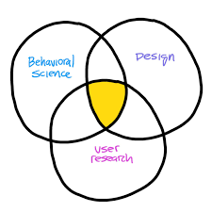

T2DAY: Support for you
Project Lead | Oversee the programme, implementation plus data collection. Provide coordination, tracking and organising. Monitor, share, progress and escalate challenges. Support T2Day workstreams.
Health and Wellbeing coach | Share improvement methods and tools Help engage people and teams Support teams in developing ideas and strategies using QI tools
Practice Nurse Educator | To deliver mentorship, education, advice and support in T2Day diabetes care. To facilitate communication between places/ primary care and secondary care team for mutual support, sharing of good practice and peer-learning.
Diabetes Specialist Midwife | To deliver mentorship, education, advice and support in diabetes care around pre-conception and pregnancy care. Identifying gaps in preconception clinic and ensuring there is a seamless approach.
Behaviour Science Campaign | Design and run a behaviour science campaign across South Yorkshire, using a COM-B approach, which has an emphasis on understanding the current barriers to engagement.
Community funds towards Faith Leaders | The aim of the initiative T2Day Interfaith Network is to bring representative / lived experience collaborators from different faith and belief groups together who have a particular interest in how faith groups can support their members to improve health and wellbeing.

Slide 54
CALL FOR T2DAY CHAMPIONS
Please contact
katie.whitehead@nhs.net
ani.kumar@nhs.net

Slide 55
Pregnancy Update

Slide 56
Measure | Local Performance (All 2021 and Combined ‘Overall’ figures include the one patient with unknown diabetes type) |  |  | Regional and national performance is reported for 2020-22 combined
 | 2021 (n=34) | 2022 (n=20) | 2021/22 Combined | Regional | England
1. Women who had early pregnancy HbA1c measurements below 48mmol/mol Type 1 Type 2 Overall | 21% (4/19) 42.8% (6/14) 32.3% (11/34) | 23% (3/13) 14.3% (1/7) 20% (4/20) | 21.9% (7/32) 33.3% (7/21) 27.8% (15/54) | 20.5% 32.7% 28% | 22% 37% 30.7%
2. Women taking the recommended 5mg dose of folic acid prior to pregnancy Type 1 Type 2 Overall | 42.1% (8/19) 21.4% (3/14) 32.3% (11/34) | 38.5% (5/13) 28.6% (2/7) 35% (7/20) | 40.6% (13/32) 23.8% (5/21) 33.3% (18/54) | 41.9% 21.1% 30% | 44% 20.5% 30.8%
3. Pregnancies where first contact with the antenatal diabetes team was before 10 weeks gestation Type 1 Type 2 Overall | 52.6% (10/19) 71.4% (10/14) 58.8% (20/34) | 84.6% (11/13) 100% (7/7) 90% (18/20) | 65.6% (21/32) 81% (17/21) 70.4% (38/54) | 82.9% 67.5% 74.6% | 79.6% 59.5% 68.3%
4. Pregnancies who had third trimester HbA1c measurements below 43mmol/mol Women who had a miscarriage or terminated the pregnancy are not included in these figures Type 1 Type 2 Overall | 14.3% (2/14) 63.6% (7/11) 38.5% (10/26) | 33.3% (3/9) 75% (3/4) 46.2% (6/13) | 21.7% (5/23) 66.7% (10/15) 41% (16/39) | 24.8% 50% 38.2% | 28.1% 55.7% 43%
5. Live births that were admitted to a neonatal unit (NNU) Type 1 Type 2 Overall | 57.1% (8/14) 63.6% (7/11) 57.7% (15/26) | 75% (6/8) 50% (2/4) 66.7% (8/12) | 63.6% (14/22) 60% (9/15) 60.5% (23/38) | 40.9% 29.3% 34.4% | 48.9% 31.7% 39.5%
6. Live births at or after 37 weeks that were admitted to an NNU Type 1 Type 2 Overall | 12.5% (1/8) 42.8% (3/7) 25% (4/16) | 33.3% (1/3) 0% (0/2) 20% (1/5) | 18.2% (2/11) 33.3% (3/9) 23.8% (5/21) | Not provided

Slide 57
Contraception
Referral to Preconception Clinic
Folic Acid 5mgs

Slide 58
Diabetes footcare referral pathway
DOES THE PATIENT HAVE ?–
  FOOT ULCERATION
    &/OR
  NECROSIS / GANGRENE
    &/OR
  ACTIVE CHARCOT FOOT
NO
YES
RISK LEVEL 6
Immediate referral to
Acute Assessment Clinic
Complete an
Acute Assessment Referral & fax to the Diabetes Centre on: 01226 434406
(Queries: 01226 4335678)
Does the patient show evidence of neuropathy or peripheral arterial disease?
NO
YES
Does the patient have additional risk factors?
(e.g. callus, limited joint mobility, foot deformity)
Does the patient have additional risk factors?
(e.g. callus, limited joint mobility, foot deformity)
NO
YES
NO
YES
Has the patient had previous foot ulceration &/or non-traumatic amputation?
NO
YES
RISK LEVEL 1
RISK LEVEL 2
RISK LEVEL 3
RISK LEVEL 4
RISK LEVEL 5
No podiatry referral needed.
See Care Plan.
Patients assessed as being in Risk Levels 2 to 5 – complete podiatry referral and forward to the Podiatry Department, New Street, Barnsley, S70 1LP.
PLEASE ENSURE THAT RISK LEVEL IS INDICATED ON THE COMPLETED REFERRAL FORM

Slide 59
Diabetes Technology(NICE Guideline)
CGM – Offer CGM - Flash Glucose Monitoring System to Adults with T2DM on Insulin (two or more times a day) if any of the following applies:-
recurrent hypoglycaemia (recurrent events that occur each week or month and have an impact on quality of life)
or severe hypoglycaemia (episodes that require assistance from another person to treat).
have impaired hypoglycaemia awareness
have a condition or disability (including a learning disability) that means unable to self monitor blood glucose levels by capillary blood glucose monitoring (fingerprick testing) but could use a Flash device (or have it scanned on their behalf). This includes people receiving dialysis.
otherwise be advised to self-measure at least 8 times a day require help from a care worker or healthcare professional to monitor glucose levels.

Slide 60
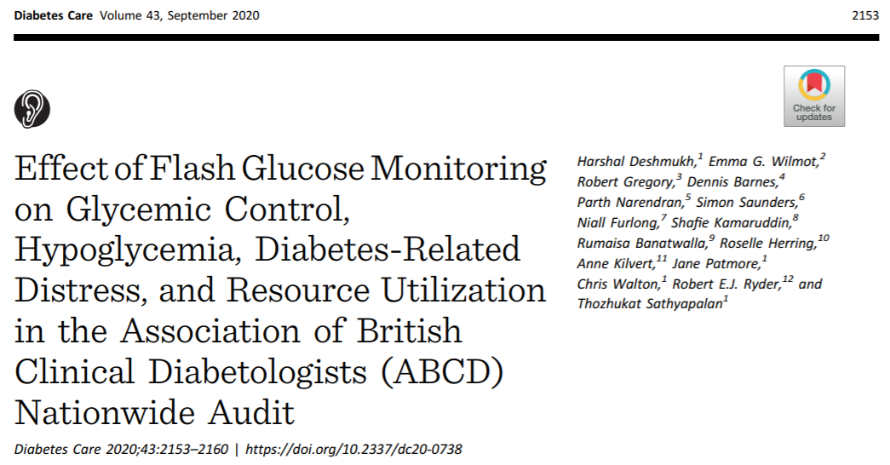
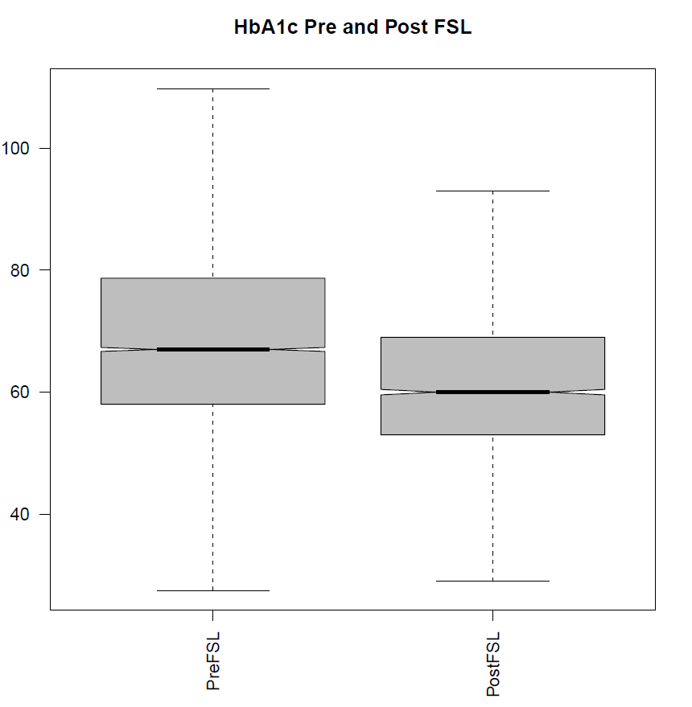

ABCD national audit
Pre-FSL HbA1c (IQR) | 68 (18)
Post FSL HbA1c (IQR) | 62 (17)
P-value* | <0.0001
5.2 mmol/mol HbA1c
The use of FSL was also associated with improvements in
Gold score
Paramedic callouts
Hospital admissions
N=3182
*P-value from Mann-Whitney U Test
Deshmukh H, Wilmot EG et al. Diabetes Care 2020 15;43(9):2153-60

Slide 61
CGM on FP10
Freestyle Libre 2 – soon to be phased out and replaced with Freestyle Libre 2 Plus
Freestyle Libre 3**
Dexcom One
Dexcom One Plus**

Slide 62
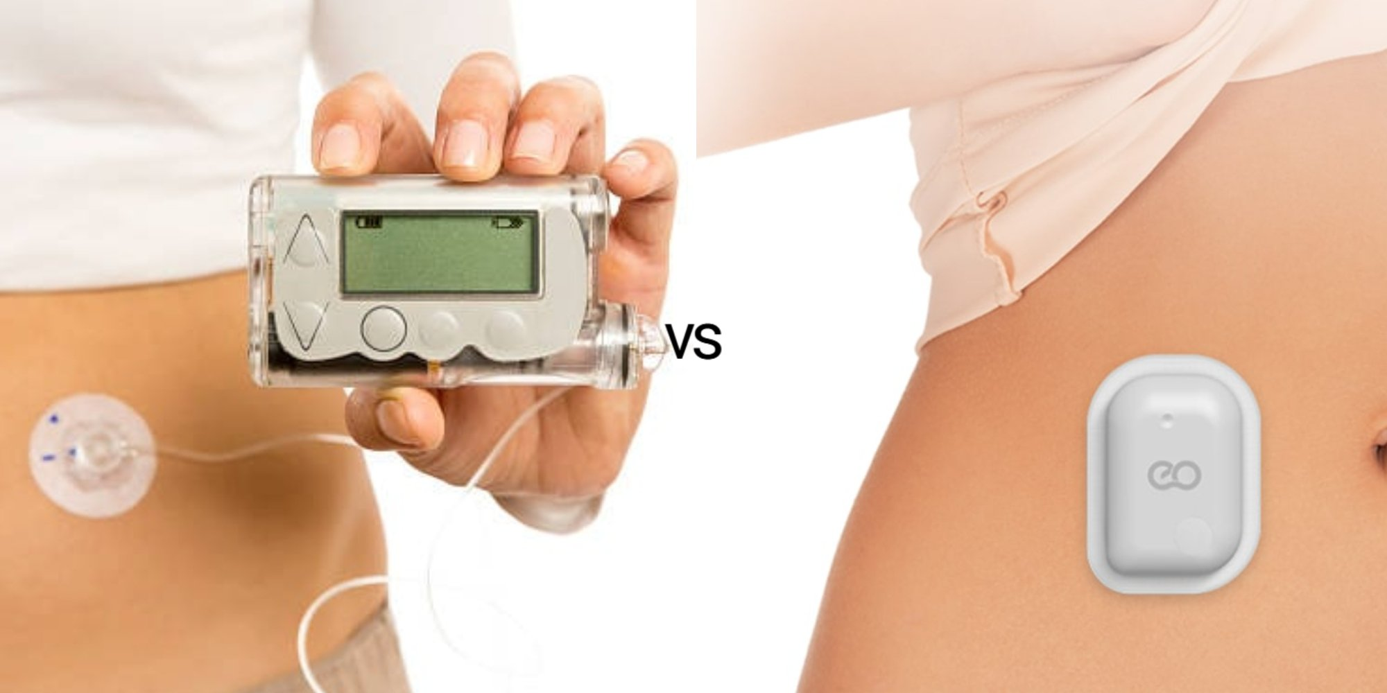
Insulin Pumps
Is a small electronic device that releases the regular insulin via a tiny tube inserted into the subcutaneous tissue through the day and night so insulin injections are no longer required.
There are two types of insulin pump:
a tethered pump
a patch pump

Slide 63
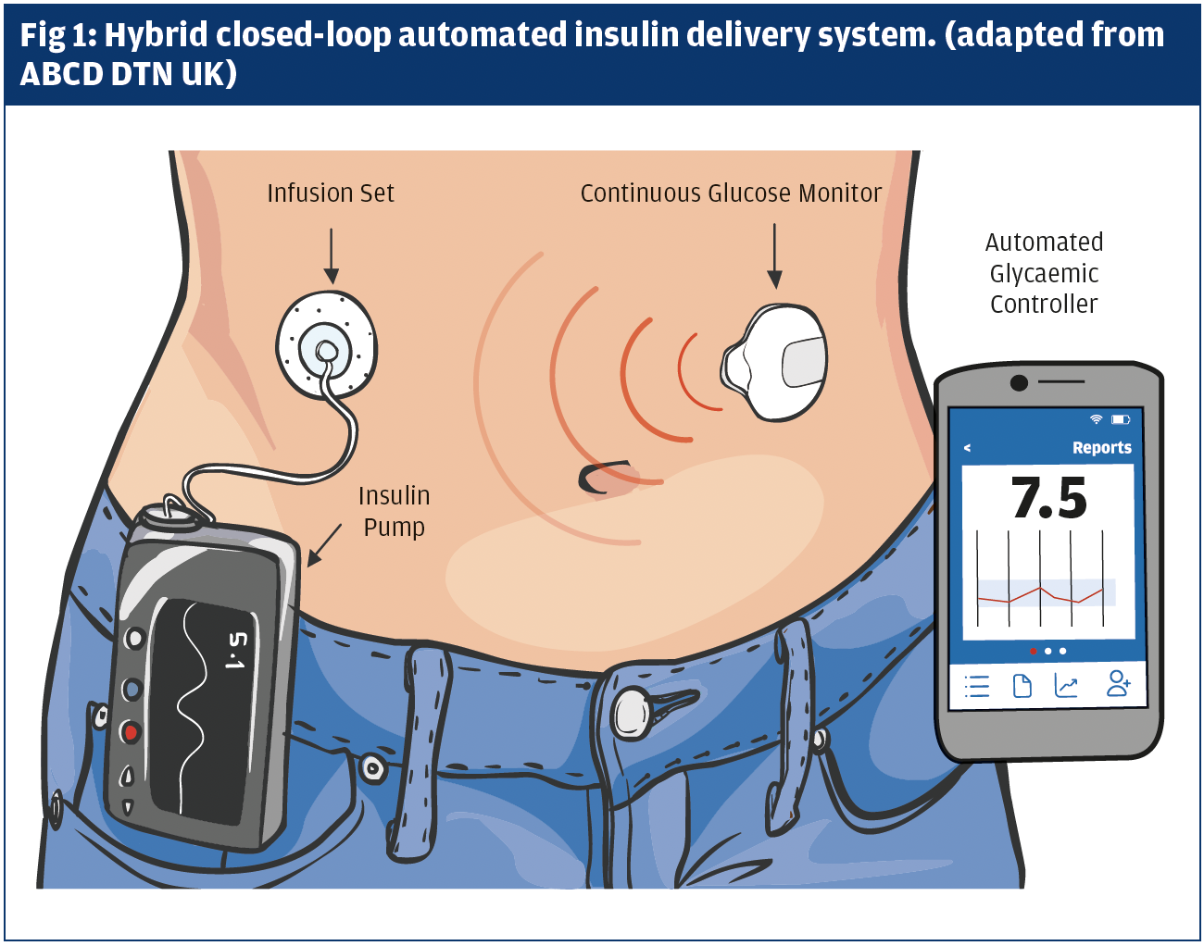
Hybrid Closed Loop Systems
A closed loop system consists of three linked medical devices that help people to manage type 1 diabetes. The three parts of closed loop system are: A continuous glucose monitoring (CGM) sensor that checks sugar levels in the body every few minutes
An insulin pump that delivers insulin into the body, and
A digital controller that analyses data from the CGM sensor and instructs the pump to deliver the correct dose of insulin to return blood sugar levels to normal. This computer programme is either contained within the pump itself, or separately e.g. within a mobile phone app.
Approved by NICE for T1DM under TA to be rolled out over 5 years.

Slide 64
Summary
Significant improvements in treatment options available for T1DM and T2DM
Rising cost of Diabetes Management
Prevention and Remission key to curtailing escalating costs
The future is bright for PwD

Slide 65
THANK YOU

